Slide 1
Introduction to R and Rstudio (Part 1)

Slide 2
Contents
Installing and configuring RStudio, R Packages, Introduction to Swirl,

Slide 3

Introduction to R
R is an open source programming language and software environment for statistical computing and graphics.
The R language is widely used among statisticians and data miners for developing statistical software and data analytics tools

Slide 4
History of R
Modelled after S & S-plus, developed at AT&T labs in late 1980s.
R project was started by Robert Gentleman and Ross Ihaka Department of Statistics, University of Auckland (1995).
Currently maintained by R core development team – an international team of volunteer developers (since 1997).

Slide 5
R resources
http://www.r-project.org/
http://cran.r-project.org/doc/contrib/Verzani-SimpleR.pdf

Slide 6
Download R and RStudio
Download R :
http://cran.r-project.org/bin/
Download RStudio :
http://www.rstudio.com/ide/download/desktop

Slide 7
Installation
Installing R on windows PC :
Use internet browser to point to : http://mirror.aarnet.edu.au/pub/CRAN
Under the heading Precompiled Binary Distributions, choose the link Windows.
Next heading is R for Windows; choose the link base.
Click on download option(R 4.2.1 for windows).
Save this to the folder C:\R on your PC.
When downloading is complete, close or minimize the Internet browser.
Double click on R 4.2.1-win32.exe in C:\R to install.
Installing R on Linux:
sudo apt-get install r-base-core

Slide 8
Installation
Installing RStudio:
Go to www.rstudio.com and click on the "Download RStudio" button.
Click on "Download RStudio Desktop.“
Click on the version recommended for your system, or the latest Windows version, and save the executable file. Run the .exe file and follow the installation instructions.

Slide 9
Version
Get R version
R.Version()
Get RStudio version
RStudio: Toolbar at top > Help > About RStudio

Slide 10
A test run with R in Windows
Double click the R icon on the Desktop and the R Console will open.
Wait while the program loads. You observe something like this.
You can type your own program at the prompt line >.

Slide 11
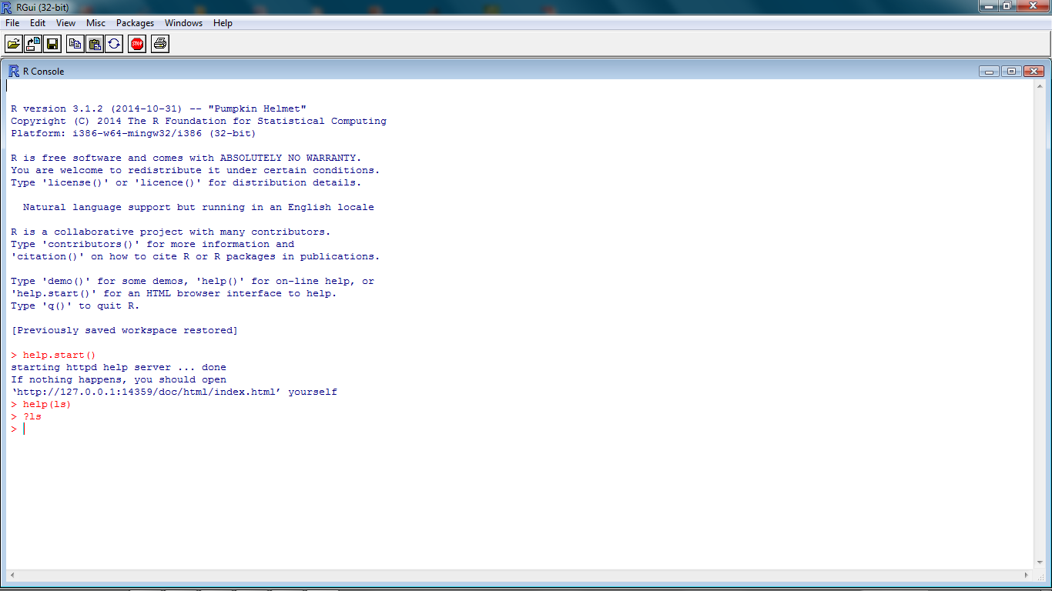
Getting help from R console
help.start()
help(topic)
?topic
??topic

Slide 12
Packages
R consists of a core and packages.
Packages contain functions that are not available in the core.
R packages are the collection of R functions, sample data, and compile codes.
In the R environment, these packages are stored under a directory called "library."
During installation, R installs a set of packages. We can add packages later when they are needed for some specific purpose. Only the default packages will be available when we start the R console.
One of the strengths of R is that the system can easily be extended. The system allows you to write new functions and package those functions in a so called `R package' (or `R library').

Slide 13
Packages
When you download R, already a number (around 30) of packages are downloaded as well.
To use a function in an R package, that package has to be attached to the system.
When you start R not all of the downloaded packages are attached, nearly seven packages are attached to the system by default.
You can use the function search to see a list of packages that are currently attached to the system, this list is also called the search path.
> search()
[1] ".GlobalEnv" "package:stats" "package:graphics"
[4] "package:grDevices" "package:datasets" "package:utils"
[7] "package:methods" "Autoloads" "package:base"

Slide 14
Packages
The function library() can also be used to list all the available libraries on your system with a short description. Run the function without any arguments
> library()
Packages in library 'C:/PROGRA~1/R/R-25~1.0/library':
base The R Base Package
Boot Bootstrap R (S-Plus) Functions (Canty)
class Functions for Classification
cluster Cluster Analysis Extended Rousseeuw et al.
codetools Code Analysis Tools for R
datasets The R Datasets Package
DBI R Database Interface
foreign Read Data Stored by Minitab, S, SAS, SPSS, Stata, Systat, dBase, ...
graphics The R Graphics Package

Slide 15
Packages
To attach another package to the system you can use the menu or the library function. Via the menu:
Select the `Packages' menu and select `Load package...', a list of available packages on your system will be displayed. Select one and click `OK', the package is now attached to your current R session. Via the library function:
> library(MASS)

Slide 16
Packages
Get library locations containing R
.libPaths()
Getting the list of all the packages installed
library()
To get all packages currently loaded in the R environment
Search()
Install a New Package
install.packages("Package Name")
e.g. install.packages("XML“)

Slide 17
Packages
Install package manually
Go to R Packages https://cran.r-project.org/web/packages/available_packages_by_name.html
Download the required package
Save the package as a .zip file in a suitable location in the local system.
Run the following command to install this package in the R environment.
Syntax:
install.packages(file_name_with_path, repos = NULL, type = "source")
Example:
# Install the package named "XML"
install.packages("E:/XML_3.98-1.3.zip", repos = NULL, type = "source")

Slide 18
Introduction to swirl
Swirl teaches you R programming and data science interactively, at your own pace, and right in the R console!
Install swirl
Open RStudio (or just plain R if you don't have RStudio) and type the following into the console:
install.packages("swirl")
Start swirl using following commands on R console:
library("swirl")
swirl()

Slide 19
Introduction to swirl
>swirl()
| Welcome to swirl!
| Please sign in. If you've been here before, use the same name as you did then. If you are new, call yourself something unique. What shall I call you? Johnny
| Please choose a course, or type 0 to exit swirl.
1: R Programming
2: Take me to the swirl course repository!
Selection: 1
| Please choose a lesson, or type 0 to return to course menu.
1: Basic Building Blocks
2: Workspace and Files
3: Sequences of Numbers
4: Vectors
5: Missing Values
6: Subsetting Vectors
7: Matrices and Data Frames
8: Logic
9: Functions
10: lapply and sapply
11: vapply and tapply
12: Looking at Data
13: Simulation
14: Dates and Times
15: Base Graphics

